Slide 1
Knowledge management
Expert System
By – Prof. Dipika

Slide 2
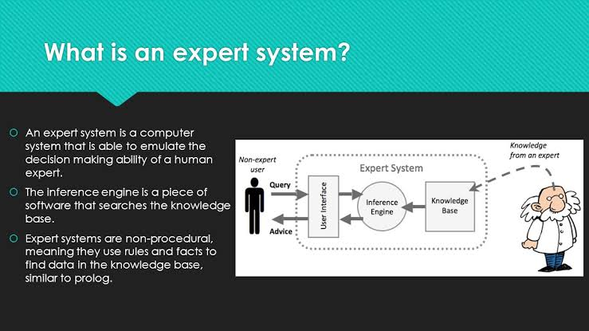

Slide 3
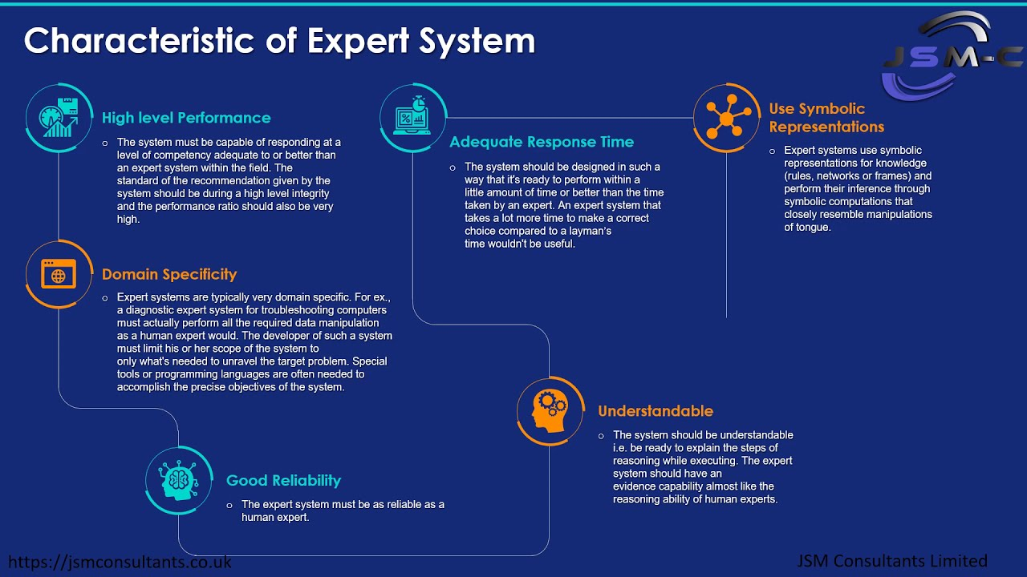

Slide 4
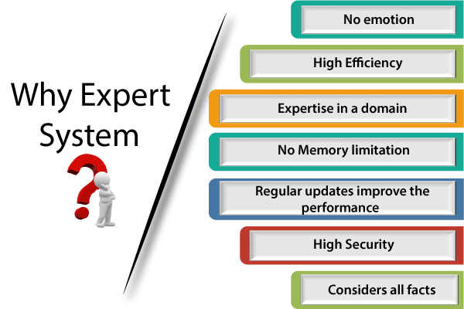

Slide 5
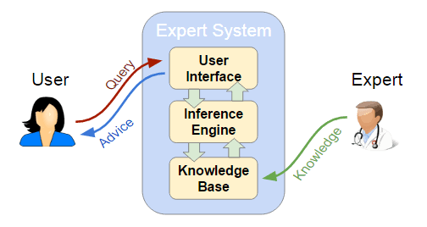
Components of An Expert System

Slide 6
Strategies used by Inference Engine
Forward Chaining
Backward Chaining

Slide 7
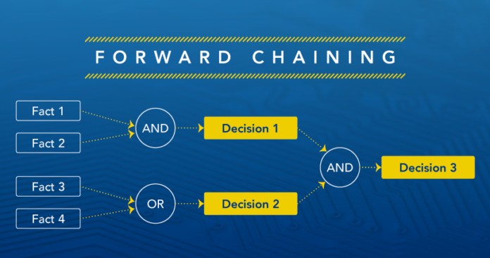
Forward chaining

Slide 8
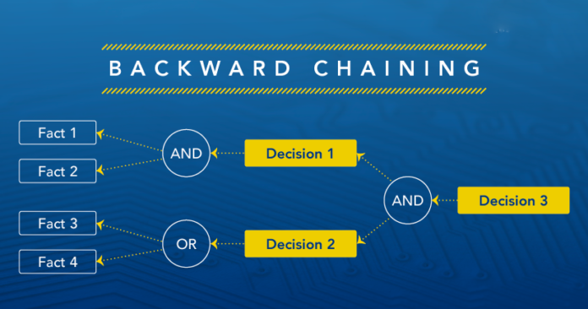
Backward chaining

Slide 9
Types of Expert System
Advisory
Dictatorial
Criticizing
Repair
Diagnosis
Instruction
Interpretation
Prediction
Design and planning
Monitoring and control
classification

Slide 10
Operation of The System
Knowledge Acquisition
Consultation
Explanation

Slide 11
Capabilities of Expert System
Advising
Instructing and assisting human in decision making
Demonstrating
Deriving a solution
Diagnosing
Explaining
Interpreting input
Predicting results
Suggesting alternative options to a problem

Slide 12
Steps to develop an Expert system project
Identify
Create a specification
Specify
Design
Document
Implement the system
Testing
Evaluation
Submission

Slide 13
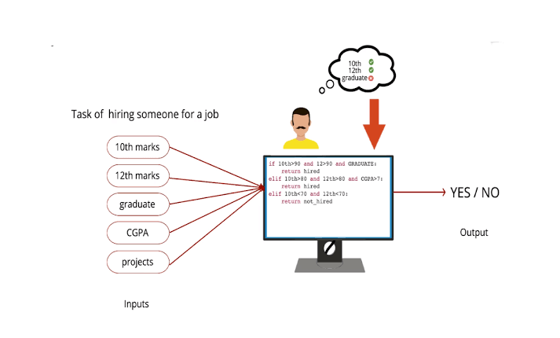

Slide 14


Slide 15
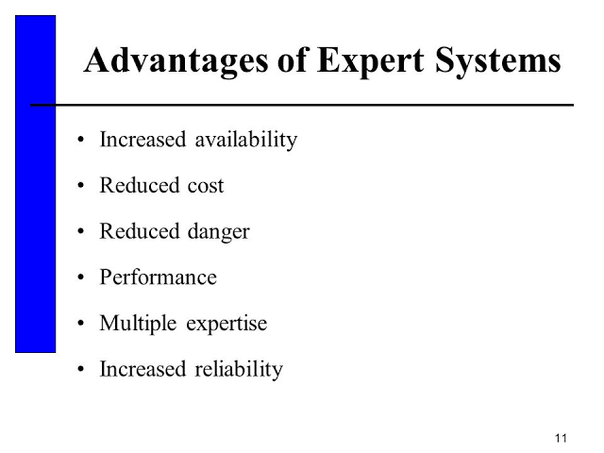

Slide 16
Disadvantages of an Expert System
Expensive to produce
Time consuming
Lacks depth
Inflexible
No common sense
Programs have errors

Slide 17
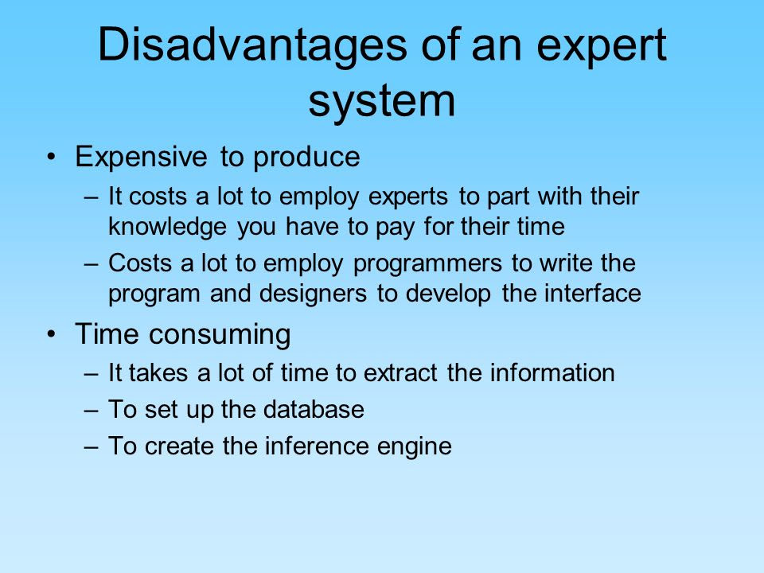

Slide 18
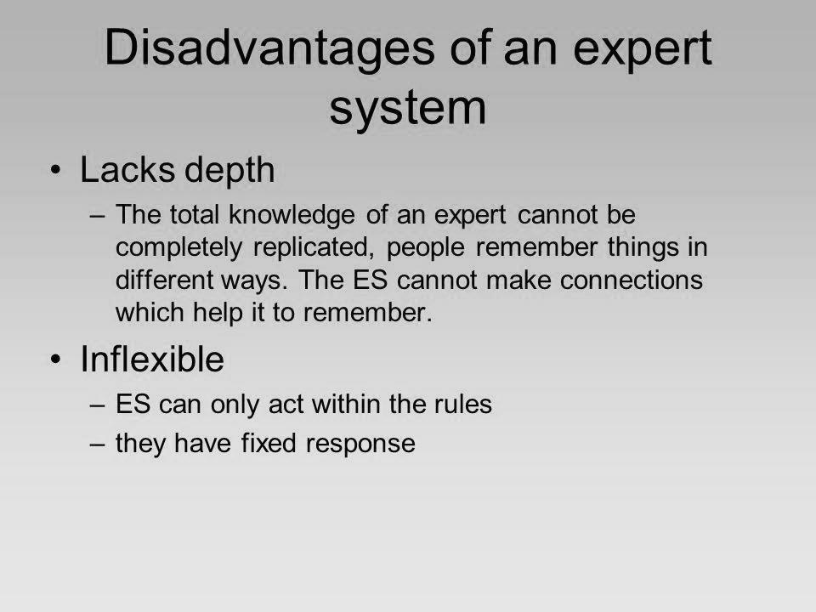

Slide 19
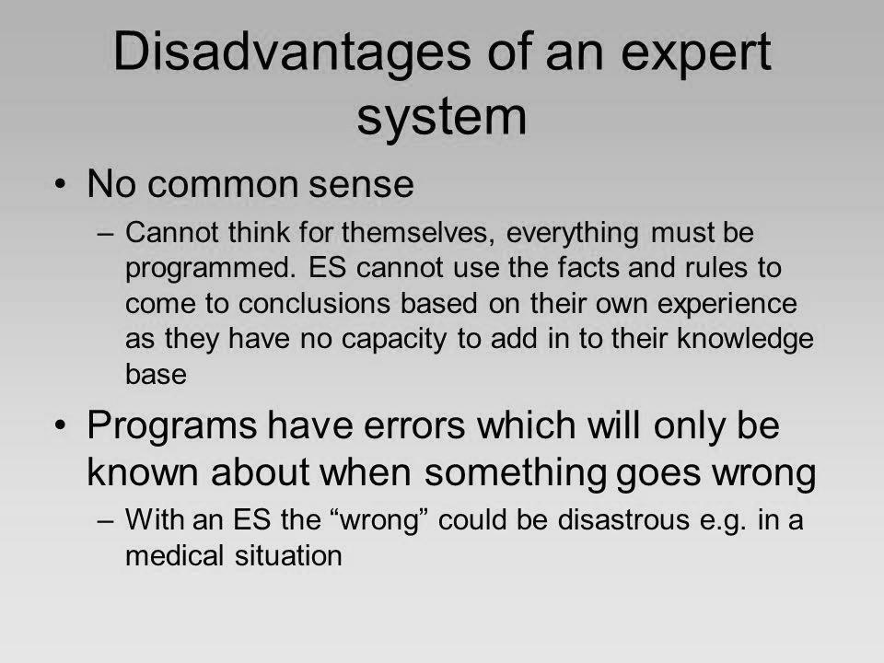

Slide 20


