Slide 1

MULTIVARIATE ANALYSIS
Presented by:Amandeep Kaur Cheema

Slide 2
CONTENTS
INTRODUCTION
MEANING
FEATURES
IMPORTANT TERMS
CLASSIFICATION OF MUTIVARIATE TECHNIQUES
DEPENDENCE METHOD

Slide 3
INTRODUCTION
The real environment is characterised by highly complex relation between variables. Univariate techniques or bivariate techniques analyze a single variable or two variables respectively on a sample of observation. However when three or more variables are to be analyzed simultaneously then the techniques applied in such a situation are called multivariate techniques. The multivariate analysis techniques are being used freely in all fields to analyze social, psychological ,agricultural and business data.

Slide 4
MEANING
Multivariate techniques have been defined by Paul.E.Green as
“A collection of procedures for analyzing the association between two or more sets of measurements that were made on each object in one or more samples of objects. If only two sets of measurements are involved the data typically are referred to as bivariate .”

Slide 5
Multivariate analysis crystallize the large volume of data into smaller and meaningful scores that convey all the information.

Slide 6

Features of Multivariate Techniques
These techniques are empirical in nature. They analyses complex data collected from real life situation
Multivariate techniques crystallize large volume of data into smaller and more meaningful scores that convey all the relevant information.
Thirdly multivariate techniques involve complex calculations. Due to this reason multivariate techniques use computer facilities for calculation purposes.

Slide 7

EXAMPLE
In business the decision to allocate budget to promotional campaigns is influenced not just by one single factor i.e. relationship with sales but other factors like nature of product , stage of product life cycle , etc. A manager needs to study all these factors not in isolation but as they affect each other.

Slide 8
Variate in Multivariate Analysis
The variate is the mathematical way in which a set of variables can be represented in one equation. Like
Vk = f (X1,X2…….Xn)
Vk = L1X1 +L2X2+L3X3+………LnXn.

Slide 9
IMPORTANT TERMS
Metric data/variables :This refers to data or variables measured on an interval or ratio scale.
Non metric data/variables :The data or variables that are nominal or ordinal in scale are called non metric data or variables.
Dependence techniques: These are the techniques that are used in situation where there are one or more variables that are dependent on independent variables.
Interdependence techniques: In certain situation the variables cannot be classified as dependent or independent ,rather there exists an interdependent relationship where each variable is influenced by another and in turn it also influences other variable

Slide 10
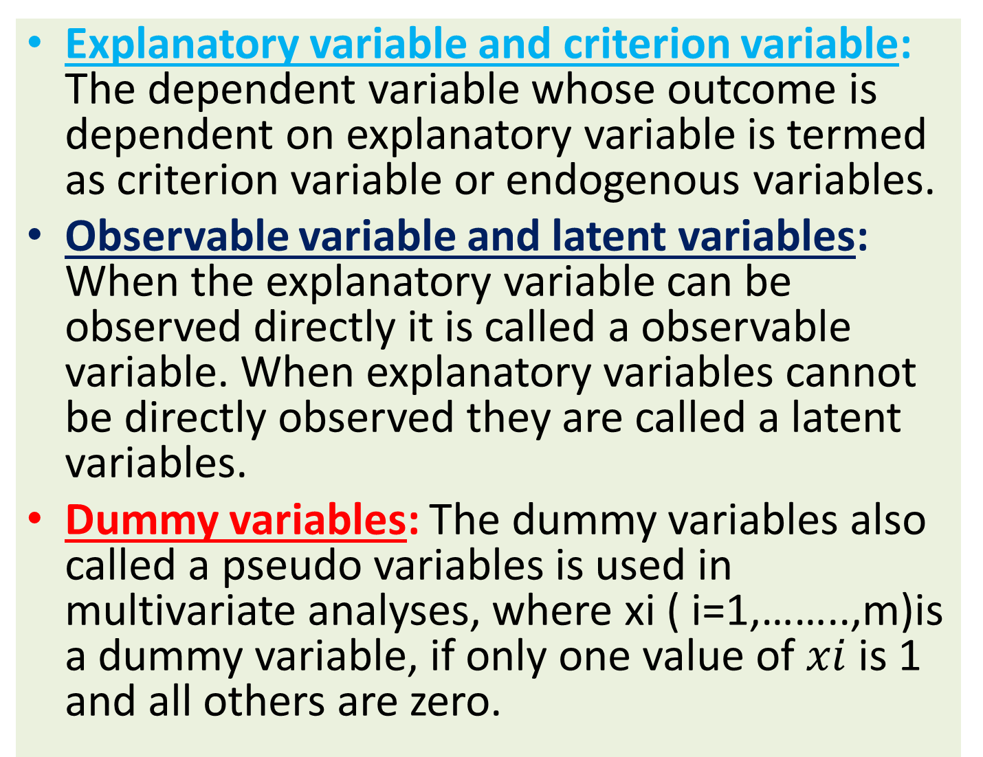

Slide 11
Nominal scale and ordinal scale
Nominal scale:- It is a type of data that is used to label variables without providing any quantitative value. It is simplest form of a scale of measure. Like data is classified on the basis of
Gender. i.e., male or female.
Profession .
Marital status.

Slide 12
Ordinal scale
It is one where the order matters but not the difference between values. It is a categorical, statistical data type where variables have natural, ordered categories and distance between the categories not known.
Like you can classified it on likert scale
( 1,2,3,4,5)
Very important-1

Slide 13
Important-2
Neutral-3
Unimportant-4
You can classified your data on the basis of
Satisfaction level

Slide 14
Interval Scale or Ratio Scale
Interval Scale:- It is the third level of measurement. Variables are measured in actual and not in relative manner
Like Fahrenheit scale for temperature
Ratio scale:- It is Quantitative in nature. It allows the researcher to compare the interval and difference
Like :- Difference between the height of six feet and five is the same as difference between three and two.

Slide 15
Classification of Multivariate techniques
Multivariate method
Dependence methods
Inter dependence methods

Slide 16
Dependence Techniques : Multivariate statistical techniques that explain or predict one or more dependent variables.
Interdependence Techniques :Multi-variate statistical techniques that give meaning to a set of variables or seek to group things together; no distinction is made between dependent and interdependent variables.

Slide 17
DEPENDENCE METHOD
Dependence method
One dependent variable
Several dependent variable
Multiple dependent variable
Metric
Nonmetric
Metric
Nonmetric
Metric
Multiple
Regression analysis
Multiple discriminant analysis
Multivariate analysis of variance
Conjoint analysis
Structural equation modeling

Slide 18
Multiple Regression Analysis
Multiple regression analysis is a measure of relationship involving a single dependent variable and two or more independent variables. It is just like simple regression analysis. It is done with more no. of independent variables.
The general form of a multiple regression model is
Y =a+b1x1+b2x2…………..+bnxn
Y= Dependent variable
X1 , X2...Xk =known independent variables
b1,b2…bk = Parameters or regression co-efficient
a=constant
e =error or residual

Slide 19
Features
It is an extension of simple regression analysis.
It is an association in which the effects of two or more independent variables on a interval scaled dependent variables are investigated simultaneously.

Slide 20
Assumptions of multiple regression
The error term of dependent variable for particular values of independent variables is normally distributed.
For each value of independent variables the distribution of dependent variable follows normal distribution.
There is a linear relationship between dependent and independent variables.

Slide 21
Independent variables are measured without errors.
Error terms are not correlated with each others.
The variance of errors of dependent variables for each set of specific values of independent variables is constant.

Slide 22
Given below is data on sales of a product, advertising expenditure and personal selling.
Sales territory | Sales (Y) DEPENDENT VARIABLE | Adv ertising(X1) INDEPENDENT | Personal Selling (No. of agents) X2 INDEPENDENT
1 | 10 | 4 | 1
2 | 8 | 3 | 2
3 | 6 | 2 | 5
4 | 12 | 5 | 2
5 | 15 | 6 | 1
6 | 9 | 4 | 2
7 | 7 | 2 | 4
8 | 13 | 6 | 1

Slide 23
Regression Equation
Y= a+B1X1+B2X2
Y = 1.95+1.96X1+0.093X2
This case regression coefficient B1=1.96 indicates that for every one thousand rupee spent on advertising and b2=0.093 indicates that sales increased by 0.093 for every one additional unit of salesman employed.

Slide 24
Multiple Discriminant Analysis
Discriminant analysis is used when dependent variable is nominally scaled and independent variable is interval or ratio scaled. Discriminant analysis is used for the following purpose:
Classification of a group of people or object into categories.
Examining if there are any significant differences between the groups created.
Develop discriminant function that explains or discriminates between the different categories.
Lastly to evaluate how accurate the classification has been.

Slide 25
The discriminant function is represented by following linear equation
Di= b0+b1X1+B2x2+……+bk XK
Di= Score on discriminant function i
b1, b2 ……bk = Discriminant coefficients
b0=Constant
X1, X2 …… Xk= Independent variables
ASSUMPTIONS OF DISCRIMINANT ANALYSIS
The group must be mutually exclusive with every case belonging to only one group.
All cases must be independent.
Group sizes of the dependent variables are not grossly different.
Independent variables are interval.
There should be absence of multi collinearity.

Slide 26
Examples where Discriminate analysis is used
A physician might record a person’s blood pressure, weight and blood cholesterol level and then categorize that person having a high, or low probability of a heart attack.
A human resource Manager might want to distinguish between applicants to hire and those not to hire.

Slide 27
PURPOSE
A major goal of Discriminate analysis is to perform classification function.

Slide 28
Steps in conducting discriminant analysis
The discriminant analysis starts with identifying the dependent or independent variables.
Thereafter the discriminant function coefficient are determined through linear equation. There is one discriminant function for a two group discriminant analysis, but for higher order the number of function is the lesser of (g-1), where g is number of categories in the grouping variable.
Once the discriminant function are estimated then their significance is determined using two steps : (a)An F-test is used to test if the discriminant model as a whole is significant.

Slide 29
If the F-test shows significance , then the individual independent variables are assessed to see which variables differ significantly in mean by group and these are used to classify the dependent variable.
The result are interpreted in the light of results obtained from the earlier steps. It has been that higher the value of the independent variable provided the discriminant coefficient is positive, the greater are the chances that individual belonging to that category.

Slide 30
Multiple analysis of variance (MANOVA)
Multiple analysis of variance is a technique that predicts multiple continuous dependent variables with multiple independent variables. The independent variables are categorical although a continuous control variable can be included in the form of a covariate. Statistical programs usually refer to any ANOVA with only one dependent variable as univariate analysis of variance or simply as ANOVA.

Slide 31
EXAMPLE
MANOVA , just like ANOVA is used to test for significant difference between means ,with a difference that ANOVA analysis a single metric dependent variable whereas MANOVA is used when there is more than one metric dependent variable at a time
for example a study is conducted to test the effect of two different text books on the performance of students which is measured by improvements in Mathematics and statistics . In this case we have two dependent variables and the hypothesis will be that both Mathematics and statistics performance is affected by the difference in text books.

Slide 32
Where used?
MANOVA is used when there are multiple continuous dependent variables with multiple independent variables. The independent variables are categorical.

Slide 33
CONJOINT ANALYSIS
Conjoint analysis is a decompositional method used to evaluate objects presented as a combination of attributes. It is quite imperative that if a researcher ask for direct response on a particular product from the consumer, consumer’s response will be highly positive .

Slide 34
OBJECTIVE OF CONJOINT ANALYSIS
Conjoint analysis estimates individual level utilities of each attribute both individual and aggregate level.
Conjoint analysis can determine the relative importance of all attributes of consumers both in individual and aggregate level.
Conjoint analysis can estimate market share of brand that differ in attribute level.
Marketers can determine the composition of most preferred brand from the corresponding utilities of different attribute levels.

Slide 35
ASSUMPTIONS OF CONJOINT ANALYSIS
A product can be described by a set of salient attributes that are mutually exclusive.
Consumers view the product as a combination of attributes that can be exchanged for others.
The total utility of product is equivalent to the sum of the individual utilities of each attributes.
A conjoint analysis model is linear.
A product that provides higher utilities is preferred to a product that provides lower utilities

Slide 36
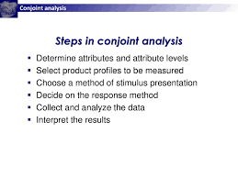

Slide 37
THANKS

