Slide 1
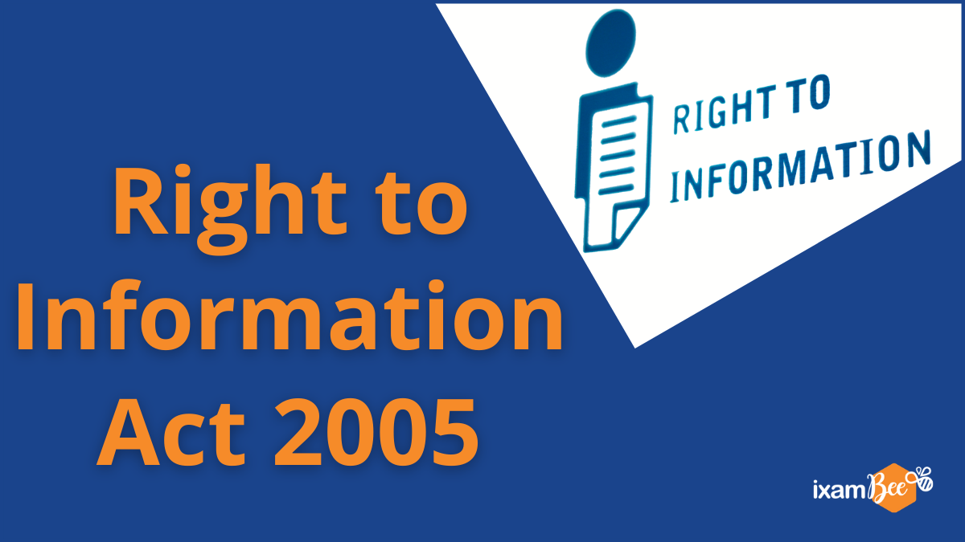

Slide 2
Presented By: Amandeep Kaur Cheema

Slide 3
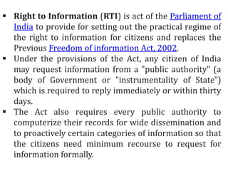

Slide 4
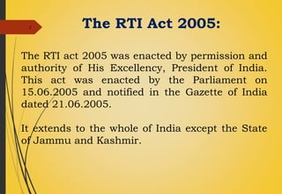

Slide 5
Where RTI is Applicable?

Slide 6
It is applicable to all constitutional authorities, including the executive, legislature and judiciary; any institution or body established or constituted by an Act of Parliament or a State legislature. It is also defined in the Act that bodies or authorities established or constituted by order or notification of appropriate government including bodies "owned, controlled or substantially financed" by government, or non-Government organizations "substantially financed, directly or indirectly by funds" provided by the government are also covered in it.

Slide 7
Objectives
The right to information act was passed in the year 2005. This law empowers Indian citizens to seek any accessible information from a Public Authority and makes the Government and its functionaries more accountable and responsible.

Slide 8
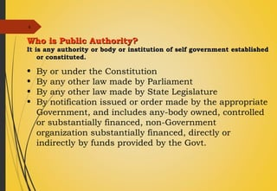

Slide 9
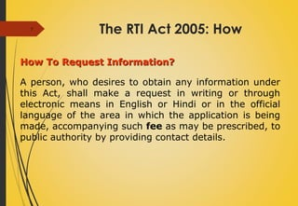

Slide 10
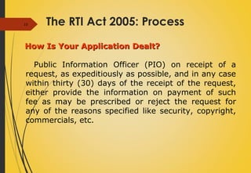

Slide 11
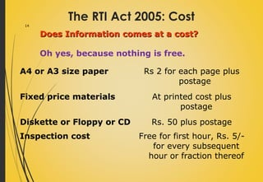

Slide 12
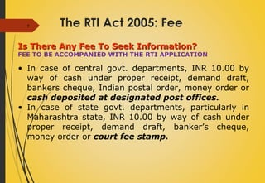

Slide 13
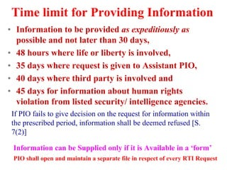

Slide 14
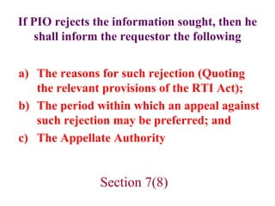

Slide 15
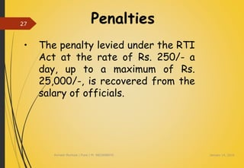

Slide 16
Definition
Public Authority means any authority or body or institution of self-government established or constituted-
By or under the Constitution
By any other law made by Parliament
By any other law made by State Legislature
By notification issued or order made by the appropriate Government, and includes any-
Body owned, controlled or substantially financed
Non-Government organization substantially financed, directly or indirectly by funds provided by the appropriate Government [section 2(h)]
Record includes-
Any document, manuscript and file.
b) Any microfilm, microfiche and facsimile copy of a document.
Any reproduction of image or images embodied in such microfilm (whether enlarged or not)
Any other material produced by a computer or any other device [Section 2(1).
.

Slide 17
Right to Information means the right to information accessible under the Act, which is held by or under the control of any public authority and includes the right to-
Inspection of work, documents, records
Taking notes, extracts or certified copies of documents or records.
Taking certified samples of materials .
Obtaining information in the form of diskettes, floppies, tapes, video cassettes or in any other electronic mode or through printouts where such information is stored in a computer or in any other device.

Slide 18
What Is Information
Information adds something new to our awareness and removes the vagueness of our ideas . Information includes any type of material in any form which includes :-
1. Records
2. Documents
3. Memos
4. E-Mails
5. Opinions
6. Advices
7. Press Releases
8. Circulars
9. Orders
10. Logbooks

Slide 19
11. Contracts
12. Reports
13. Samples
14. Papers
15. Models
16. Data Materials held in Electronic form etc. and information relating to any private body which can be accessed by a public authority under any other law for the time being in force [Section 2(f)］

Slide 20
Meaning
RTI stands for Right to Information. Right to Information Act 2005 mandates timely response to citizen requests for government information. Right to Information empowers every citizen to seek any information from the Government, inspect any Government documents and seek certified photocopies thereof. Right to Information also empowers citizens to official inspect any Government work or to take the sample of material used in any work
.Right to Information is a part of fundamental rights under Article 19(1) of the Constitution. Article 19 (1) says that every citizen has freedom of speech and expression.

Slide 21
Features
The RTI Act’s major characteristics are as follows:
1. RTI Act 2005 empowers every citizen to:
Ask any Questions from the Government or seek any information
Take Copies of any government documents
Inspect any government documents.
Inspect any Government works
Take samples of materials of any Government work.

Slide 22
In each department, at least one officer has been designated as a public information officer (PIOs). He/She accepts the request forms and provides information sought by the people (section 5(1)).
Any person seeking information should file an application in writing or through electronic means in English or Hindi (or in the official language of the area) along with the application fees with the PIO/APIO (section 6(1)).
Where the applicant is deaf, blind, or otherwise impaired, the public authority is supposed to provide assistance to enable access to the information, including providing such assistance as may be appropriate for the inspection (section 7(4)).

Slide 23
Besides the applicant's contact details, the applicant is not required to either give any reasons for requesting the information or any other personal details (section 6(2)).
The PIO can deny information in some cases/matters. The various exemptions from disclosure of information are listed in Section 8 of the RTI Act.
Any information that cannot be denied to parliament or legislative assembly cannot be denied to a common

Slide 24
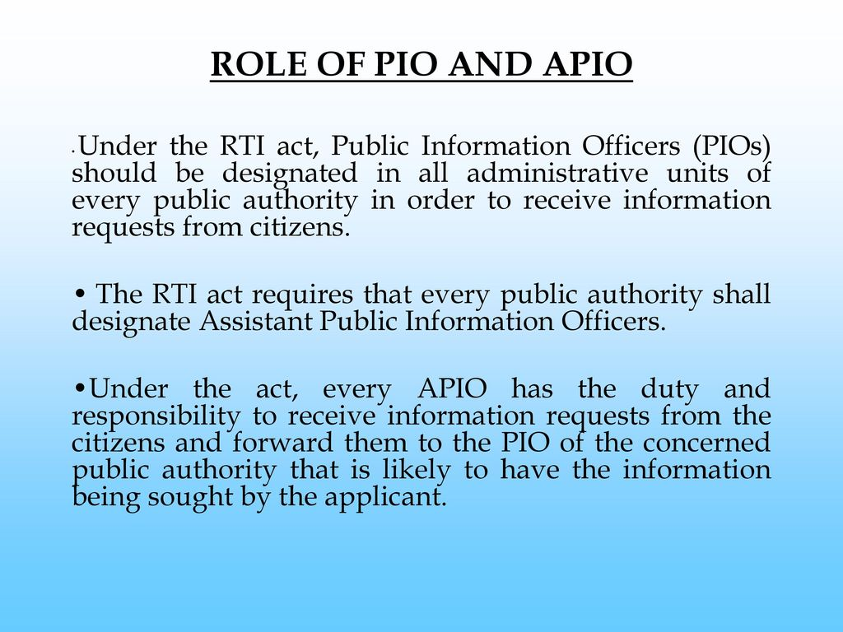

Slide 25
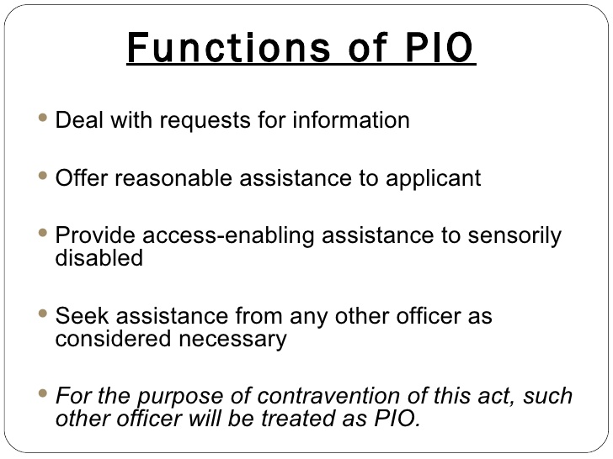

Slide 26
