Slide 1
Knowledge based Economy
By -
Prof. Dipika

Slide 2

Meaning
Knowledge-based economy is concerned with the use of a knowledge to produce economic benefit, especially in high technological, business such as computer software,
telecommunication
as well as
educational and
research institutions.

Slide 3
Definition
Knowledge economy is one that creates disseminates and uses knowledge to enhance it's growth and development.
- World Bank institute

Slide 4
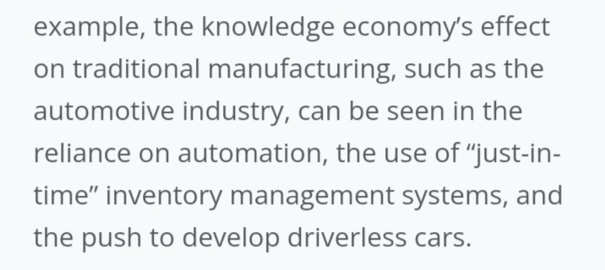
Example
1.

Slide 5
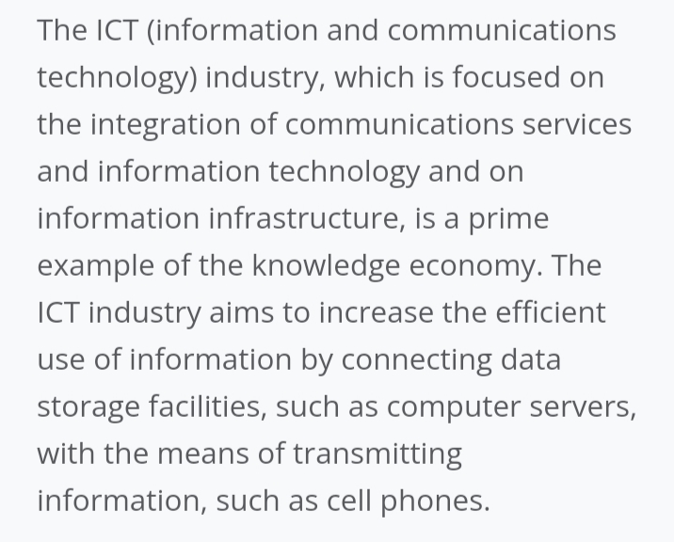

Slide 6


Slide 7
The knowledge economy represent a "soft discontinuity " from past - it is not a "new" economy operating to one new set of economic law.
The knowledge economy is present in all sectors of economy, not just in the knowledge incentive industry.
The knowledge economy has a high and growing intensity of ICT usage buy well-educated knowledge worker.
A growing share of GDP devoted to knowledge intangibles compared with the physical capital.

Slide 8
The knowledge economy consists of innovating, organizations using new technologies to introduce process, organizational and presentational innovations.
Knowledge economy organizations reorganize work to allow them to handle, store and share information through knowledge management practices.

Slide 9
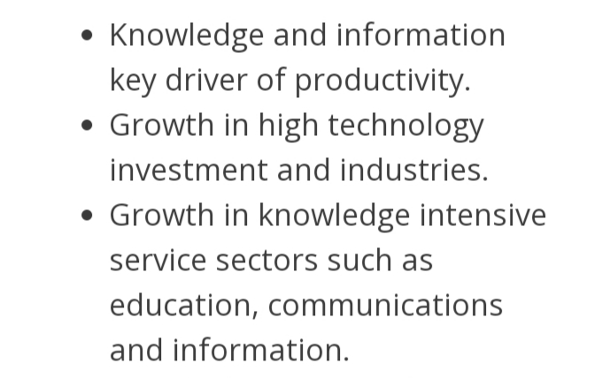

Slide 10
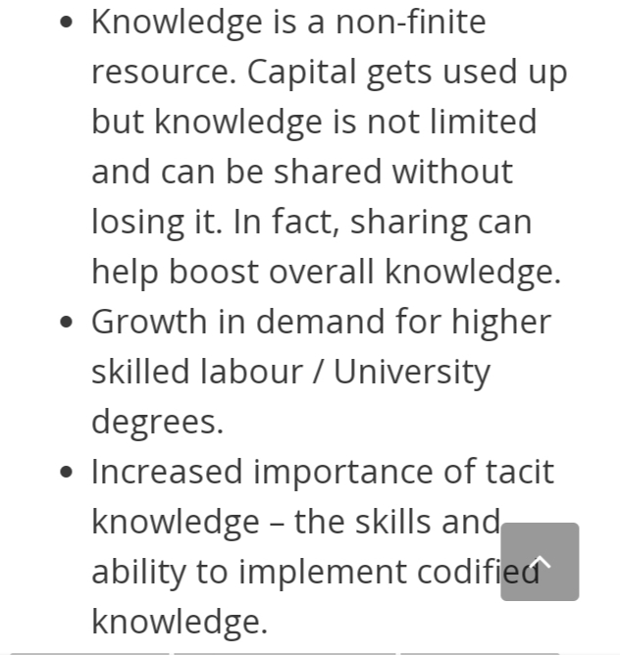

Slide 11
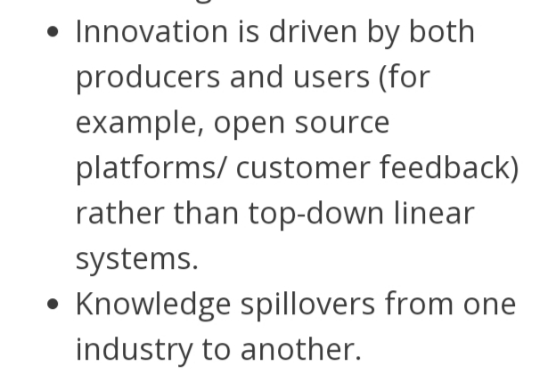

Slide 12
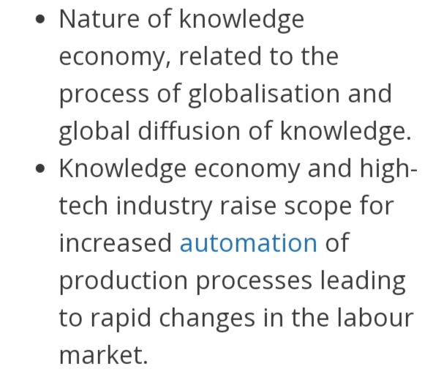

Slide 13
Main issues of building knowledge economy

Slide 14
Investments can make technology more valuable, but this can lead to sustained GDP growth only if the company have sufficient human capital. This mean that formal education training and on- the job learnings are essential for obtaining skilled workforce and management and thus advancing the economy and achieving prosperity.

Slide 15
2. Lifelong learning is also important for advancing the knowledge of individual, enabling them to change occupation and enabling enterprises to get enough workers with appropriate education.
3. Stronger direct links between business and academic world should be developed enterprises should make more use of scientist and engineers as a source of expertise.

Slide 16
4. Managers in firms must be able to manage the innovation process, improve quality of products and service and position of the products in the market.
5. Special importance should be paid to the field of knowledge management that is management of production, sharing and using the knowledge capital in the organization.

Slide 17


